Slide 1

Using DCGAN Model to Generate Anime Avatar And using CNN to classify gender
Siyu Fang, Yueqi Pan

Slide 2
Introduction
This project, we can divide into five parts ：
Web crawling around 6000 anime images from Google to create our dataset
Using the face detector for anime to detect the faces of anime characters and extract faces from images
Generate anime avatars from real anime avatar by using DCGAN(Deep Convolutional Generative Adversarial Networks)
Build a CNN(Convolutional Neural Network) model to classify the gender of anime character avatars
Adding a frame to avatar

Slide 3
Structure
Web crawling from Google
(modification part)
Extra faces from images and create avatars
(modification part)
Generate images by using DCGAN
(DEMO)
Gender
Classification by using CNN
(modification part)
Adding
frame to avatar
(modification part)

Slide 4
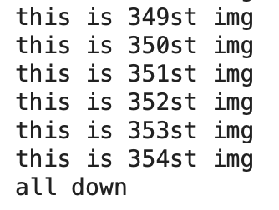
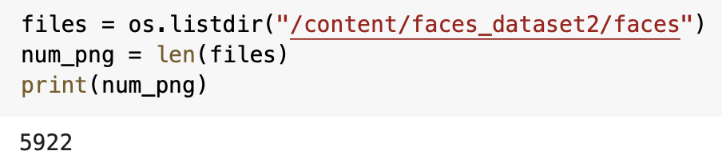
Web Crawling From Google
Installing selenium and using selenium to pair up with Google Chrome to web crawling google images
we can download around 350 images per query.
In order to get enough images in our dataset, we repeat the process 17 times, and get 5922 images in total.

Slide 5
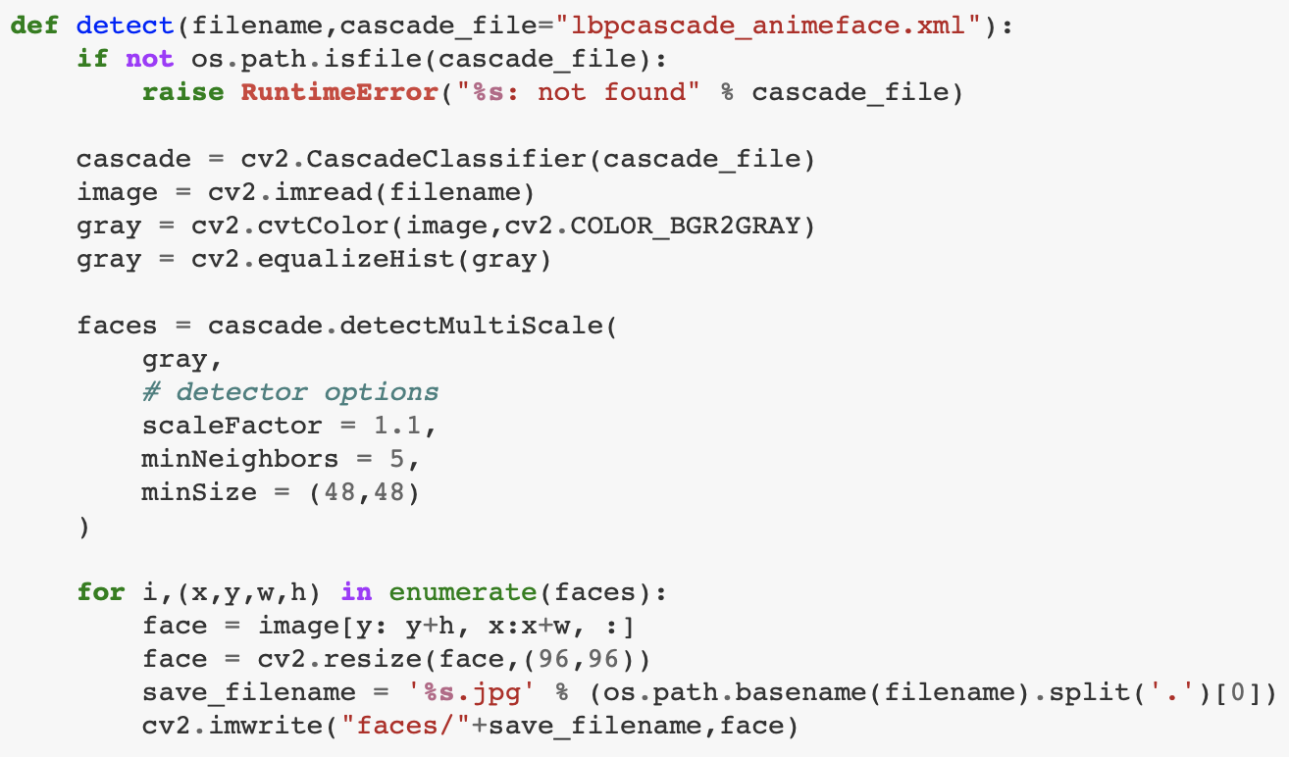
Extract Faces and Create Avatars
Cropping images by extracting faces using the anime face detection algorithm:
A cascade file lbpcascade_animeface
It’s a face detector for anime/manga Using OpenCv
Using CV2. CascadeClassifier, which is an effective object detection method

Slide 6
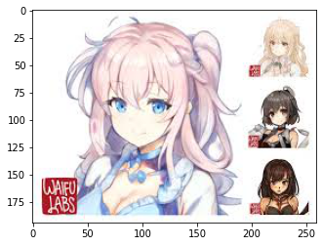
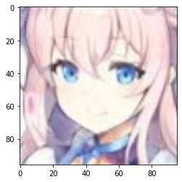
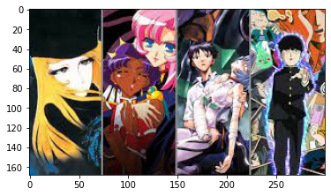
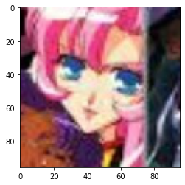
Result – For Crawling and Cropping

Slide 7
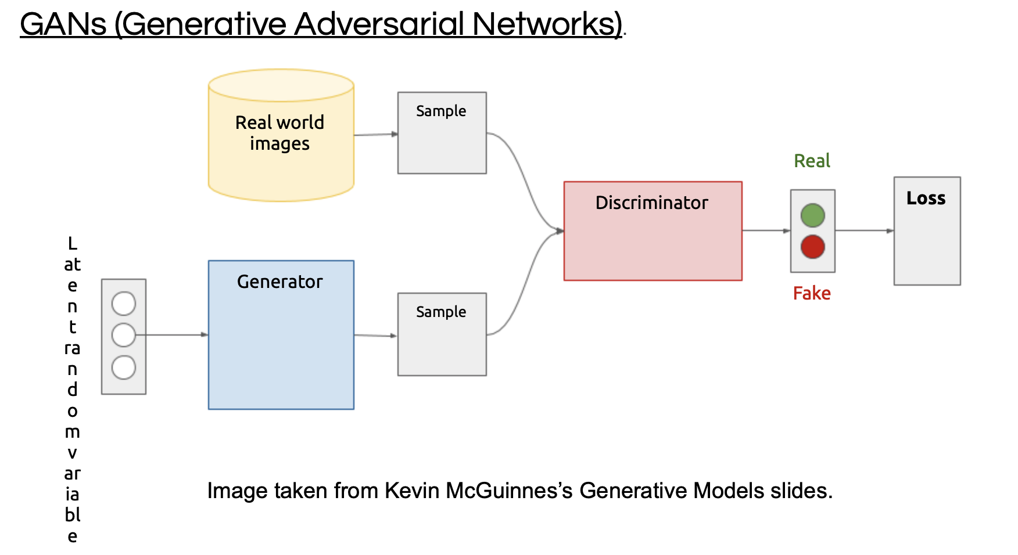
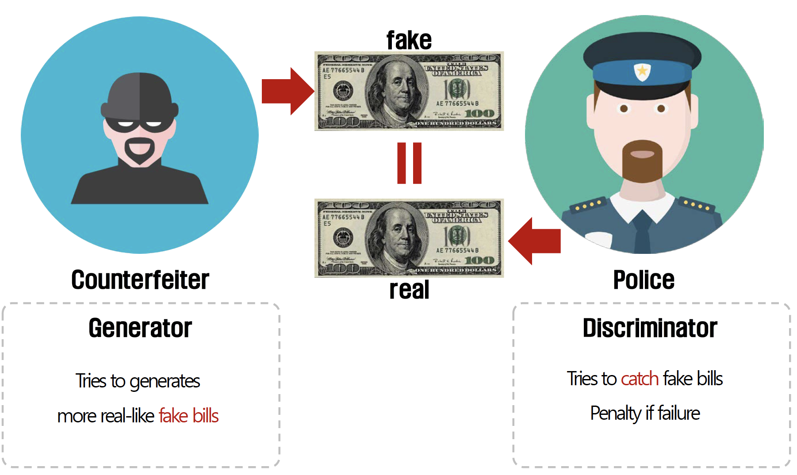
DCGAN

Slide 8
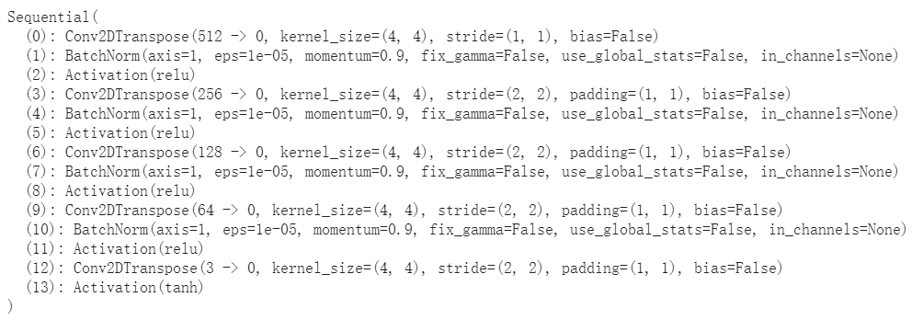
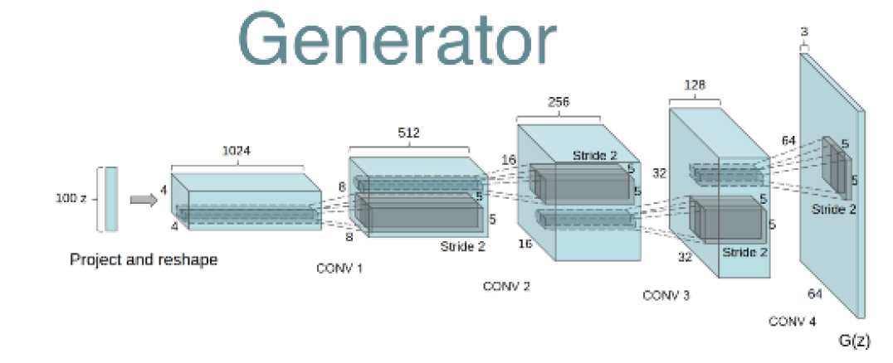
DCGAN
For Generator

Slide 9
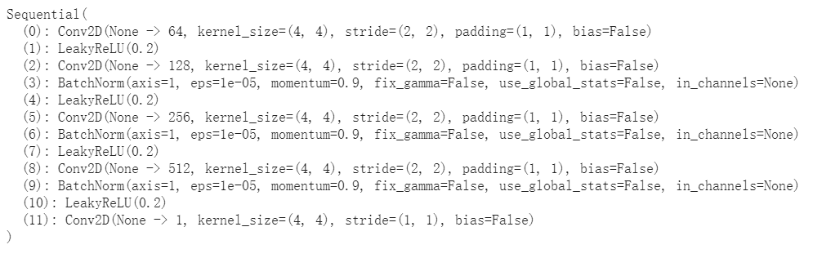
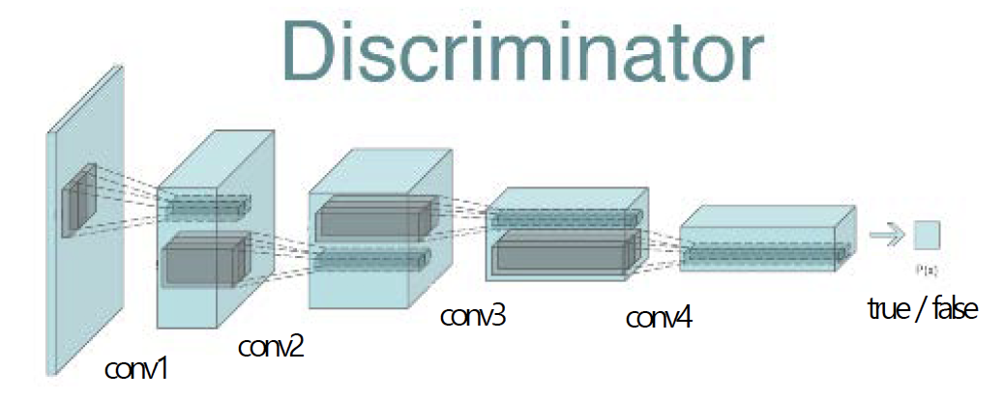
DCGAN For Discriminator

Slide 10
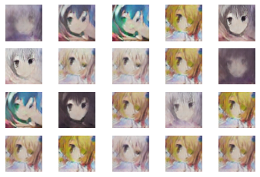
Result – For Generation
Epochs=30
Batch size = 64
latent_z_size = 100
lr = 0.0002
beta1 = 0.5
binary cross-entropy as our loss function
Adam optimizer

Slide 11
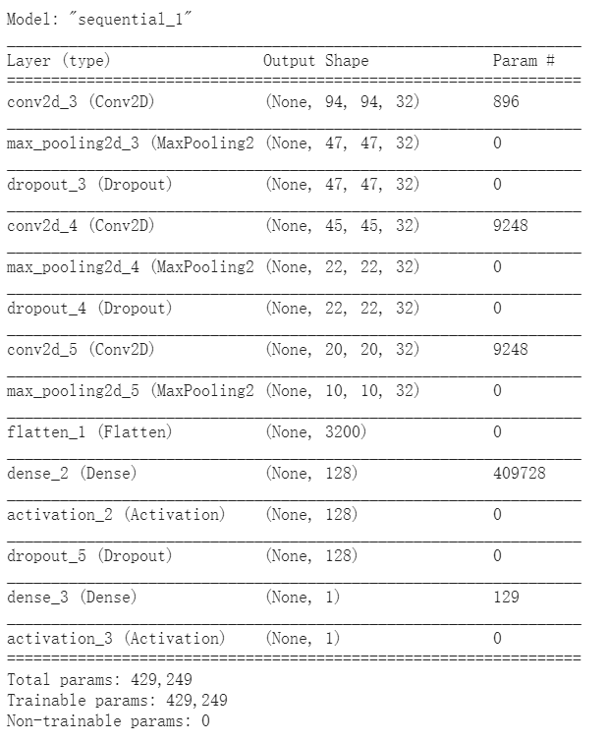

Gender Classification – Using CNN

Slide 12




Result – for Gender Classification

Slide 13


Adding Head Avatar Frame

Slide 14
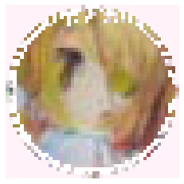
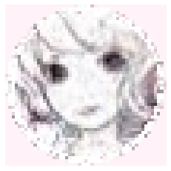
Result – Adding Avatar Frame

Slide 15
Problem
Crawling code only can craw 360 pictures around, so we need to use almost 30 different words to collect near 10,000 pictures. (Example: anime, anime girl, anime cute girl)
Pictures for data using are paucity.

Slide 16
The model by using CNN for generator and discriminator is too simple – maybe using other network.
The style of the anime avatars is very different

Slide 17
Thanks for listening
Project Github Link: https://github.com/YueqiPan/Final.git - with 3 parts
Original Code: https://gluon.mxnet.io/chapter14_generative-adversarial-networks/dcgan.html#Set-training-parameters
Idea Source: https://qiita.com/mattya/items/e5bfe5e04b9d2f0bbd47

